Slide 1
EMMAUS PPT GUIDELINES
Please do not alter the template.
Do not do custom animation, other than allowing bullets to “appear” – one level deep only (sample slide attached).
Be careful about shrinking the fonts (28pt min)
When in doubt, please defer to the LD of the weekend.
Suggestion – use Emmaus logo as 1st and DAEC logo on last slide.

Slide 2


Slide 3
NAME OF TALK
DAEC Men’s Walk #33
Your Name

Slide 4
Sample Bulleted slide
First Point – definition or example
Another Point – definition or example
One More Point – definition or example
Sample
The theme stated … in a Catchphrase

Slide 14
#9 - Obstacles to Grace
The next 3 slides may be used in the Obstacles to Grace talk.
Delete them if you are not delivering this talk.

Slide 15
Idolatry
Blasphemy
Resisting
Ignoring
Disobedience
Unbelief
Ignorance
Pride
Unforgiveness

Slide 16
Idolatry
Blasphemy
Resisting
Murder
Coveting
Stealing
Laziness
Addiction
& Abuse
Gossip
Dishonor
Lying
Ignoring
Disobedience
Unbelief
Ignorance
Pride
Unforgiveness

Slide 17
Idolatry
Blasphemy
Resisting
Murder
Coveting
Stealing
Laziness
Addiction
& Abuse
Gossip
Dishonor
Lying
Ignoring
Disobedience
Unbelief
Ignorance
Pride
Unforgiveness

Slide 18
Piety-Study-Action
The next 3 slides are used in:
#5- Life of Piety
#6- Grow through Study
#8- Christian Action
Delete them if you are not delivering these talks

Slide 19

Piety

Slide 20

Study

Slide 21



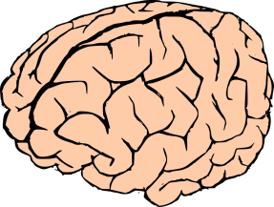
Action
LIFE IN GRACE
P
I
ETY
ACT
ION
STUDY

Slide 22


